Slide 1


JNTUA COLLEGE OF ENGINEERING PULIVENDULA - Department of CSE
HEALTH BLOOM
- Care you can believe in
By -
Shireen Syed [17-553]
Divya Sree [17-541]
Jaya Prakash [17-532]
Guided by :
T. Niranjan Babu M.Tech
Assistant Professor(Adhoc)

Slide 2
Contents
Introduction
Need for study
Motivation and scope
Research Gap
Problem Statement
architecture
Objectives
References

Slide 3
introduction
In today’s world, everyone is struggling to prioritize their health in their busy lives , but they can’t be aloof for longtime as it’s an important thing as life itself.
People increasingly rely on technology to take care of themselves and meet their health goals in parallel with their ceaseless schedules.
The medical app provides a reminder for the people’s daily medications, their appointments with the doctors, locates and shows nearby hospitals, availability of beds at that particular hospitals, providing video calls, an option to alert contacts in emergencies, an option to add important notes in one place, helps in tracking the person's important health vitals.

Slide 4
Need for study
Dart is the pedestal that supports the most trending framework Flutter, where as Flutter is most often used to make cross-platform applications.
Dart is the programming language designed for client development, such as for the web and mobile apps. It uses a code that looks a bit like ‘C’ but is an object-oriented programing language.
The covid-19 pandemic has made everyone conscious not only of the hygenic practices but also boomed up the telecommunication mainly making the video-conferencing more robust with the necessity of ubiquitous implementations that it has . Now people need not be actually together , all the miles in between are melted into a bunch of finger taps and sturdy network bandwidth

Slide 5
Need for study
So creating an app for remotely contacting doctors is next booming idea that has already proven its worth . And we are doing it so with the flutter framework powered by dart language and exploiting the available open source APIs and make it possible for a person to contact remotely and securely an authorized reliable individual.
What’s even more fascinating is that even healthcare professionals are using smartphone health applications. Doctors can now remotely access patient’s health data, monitor their progress, and provide real-time guidance.

Slide 6
Motivation and scope
Do you know..???
The global medical app market has a tremendous growth potential is expected to generate a revenue of around USD 111.1 billion. Adoption of modern technology in the form of healthcare apps, is the way to go. It’s truly a win-win for both healthcare providers and patients.
An important factor to consider is that the digitization of healthcare and technology can never completely replace the human touch, but there are many operations that can make significant changes in a person’s health and life.
The main reason of creating the app is to help people by intimating the availability of beds in the nearby hospitals so that they come to know where they have to go for efficient treatment in severe situations.
The other reason is, this app shows the growth of health by the feature “Health-Tracker” added in the app. And also reminding them to take the pills at a particular time under the doctor’s prescription.

Slide 7
Research gap
After observing many health care apps that are available in the appstore and playstore which have ways of facilitating appointments, reminders, check-ups, supervision on the go, offer a host of other benefits, and video calls ,medicine delivery at home etc.
We realized that all those apps lack a premier function which is fetching the availability of beds in the nearby hospitals which could be a life saver in severe conditions .so we intend to implement it along with some of the aforementioned features.
This feature would be more efficient when coupled with routing and navigation to that nearby hospital, which is an addon in the fulfilling the gap.

Slide 8
Problem statement
people now a days with all those hectic schedules to keep up with and living under constant stress are leading to a lot more medical issues and illnesses than we are supposed to. With increased problems and not so increase in the number of physicians to treat patients, the queues in the clinics and the waiting time for a troubled individual to get treated are increasing .
Although visiting a doctor when feeling ill is advisable but with lots of important things at stake the idle time that’s infront of it is not recommendable. After examining these issues virtual meet with the doctor is more appealing that saves a person from both tiring commute to hospital and waiting there.

Slide 9
PROBLEM STATEMENT
We are implementing a project of creating an app that acts like a interface between doctors and patients .which helps a person in getting necessary advice from a doctor right from where they are and if not sufficient making appointment with doctor . Also getting the information of the nearby hospitals and the number of beds vacant in them is the prime feature which has proven to be more important information in this pandemic. Also to alert the close assosciates is also a concern that is going to be addressed in this project.

Slide 10
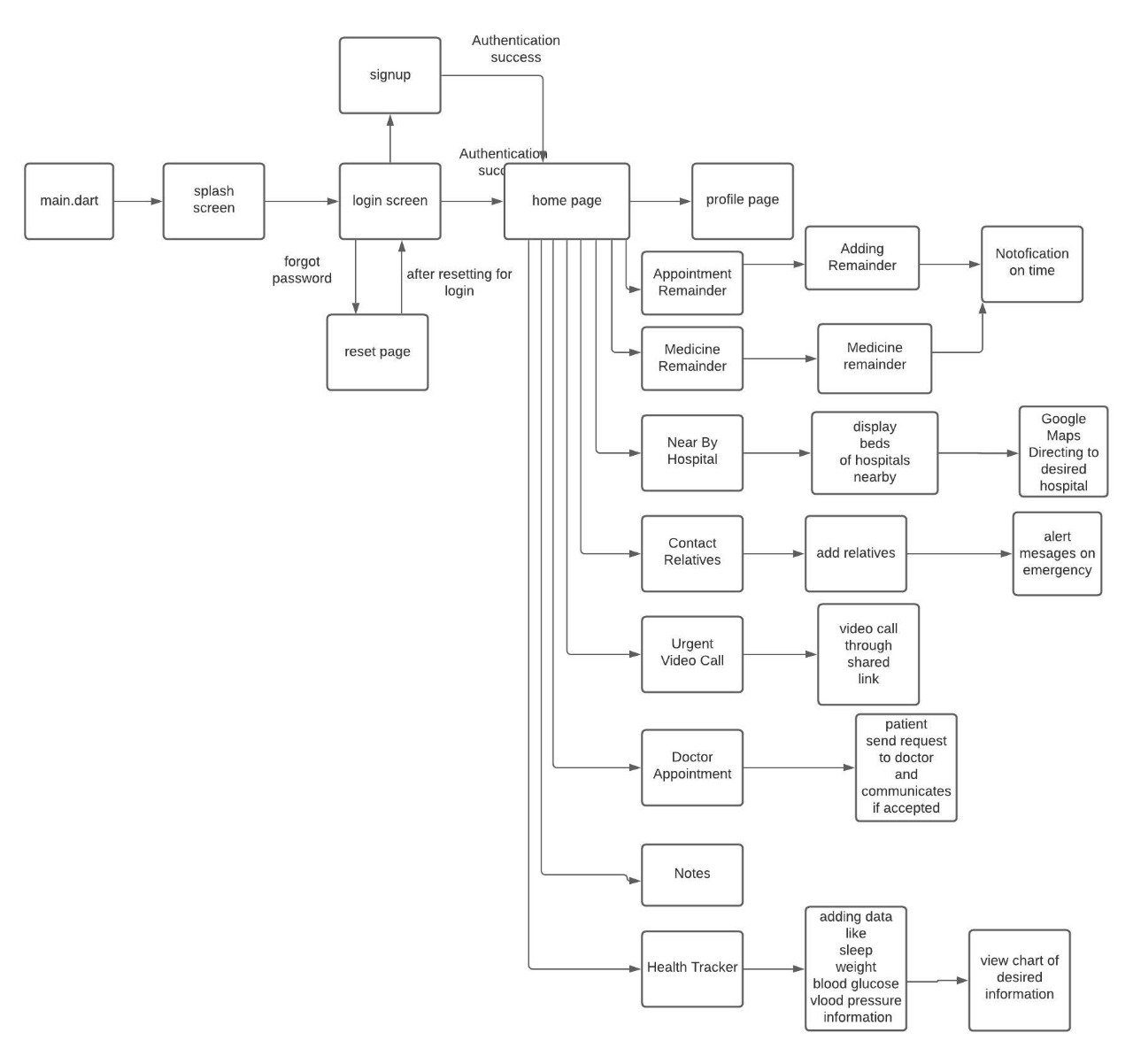
ARCHITECTURE
ARCHITECTURE

Slide 11
objectives
The objective of our project is to design app in such a way that the individual can track his health, medications etc. The features of our project are
* Doctor Appointments
* Appointment Remainder
* Medicine Reminder
* Locate Nearby Hospitals
* Alert Emergency contacts with location
* Emergency Video Calls
* Health Tracker
* Notes

Slide 12
modules
Doctor Appointment
Appointment Reminder
Medicine Reminder
Locate Nearby Hospitals
Contact Relatives
Urgent video calls
Health Tracker
Notes

Slide 13
implementation
The health care app is developed successfully as mentioned in previous chapters. And the features are working fine .Doctor appointment is implemented successfully and the reminders for medicine and the appointment are working fine .They show the features of notifying when it is due time. Finding the nearby location of the nearby hospital works fine and the routing and navigation is easier and shows real time traffic too. The beds in the hospital are shown accurately with the data uploaded in the datatable . The graphical representation of the health trackers are successful and insightful. Note making is even simpler now as it can be written in the app itself. Prioritization is working fine. Alerting contacts at emergency situations is working fine with the intricate featuring process.

Slide 14
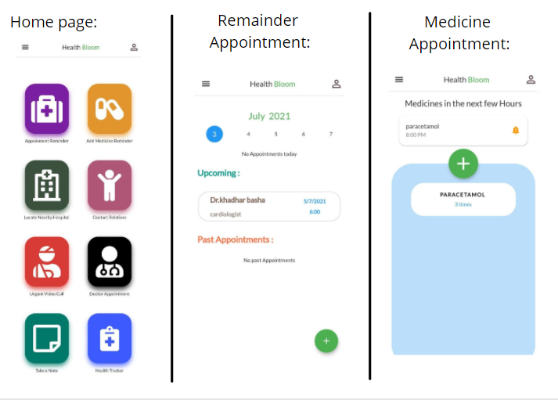
Result analysis

Slide 15
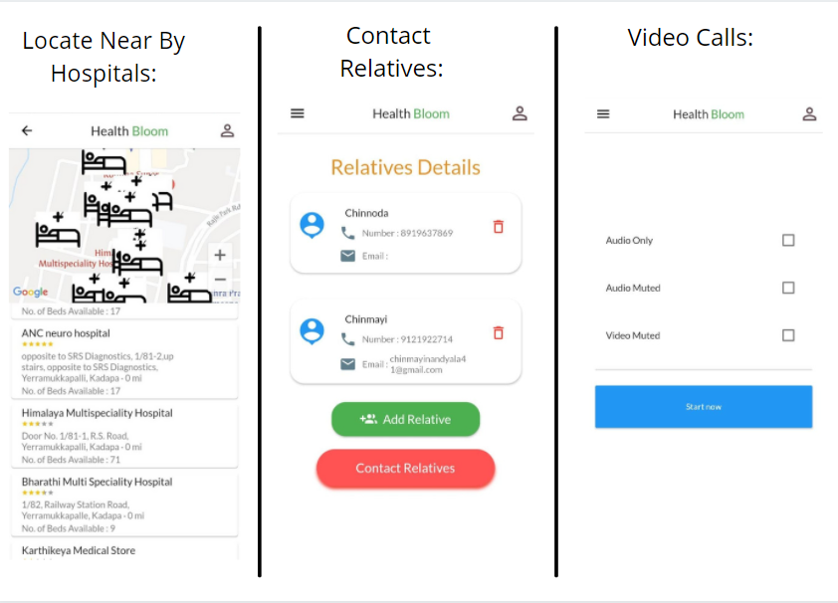
results

Slide 16
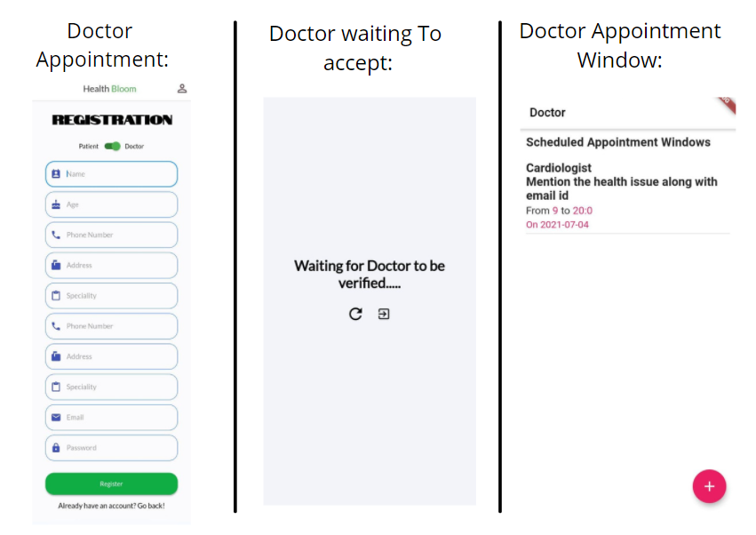
results

Slide 17
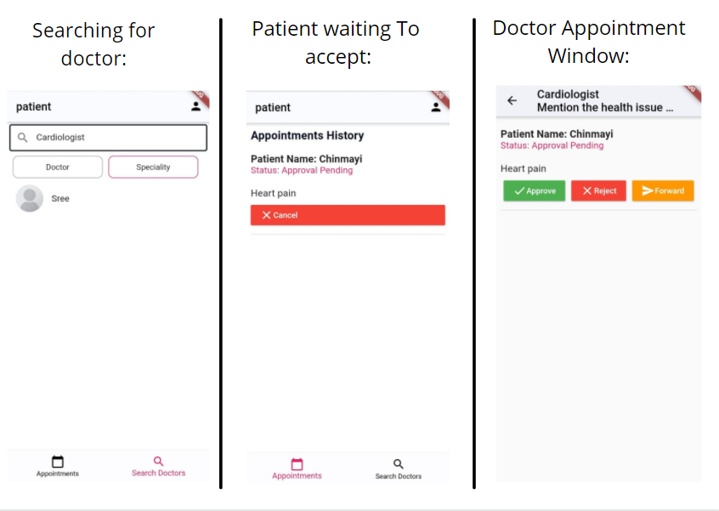
results

Slide 18
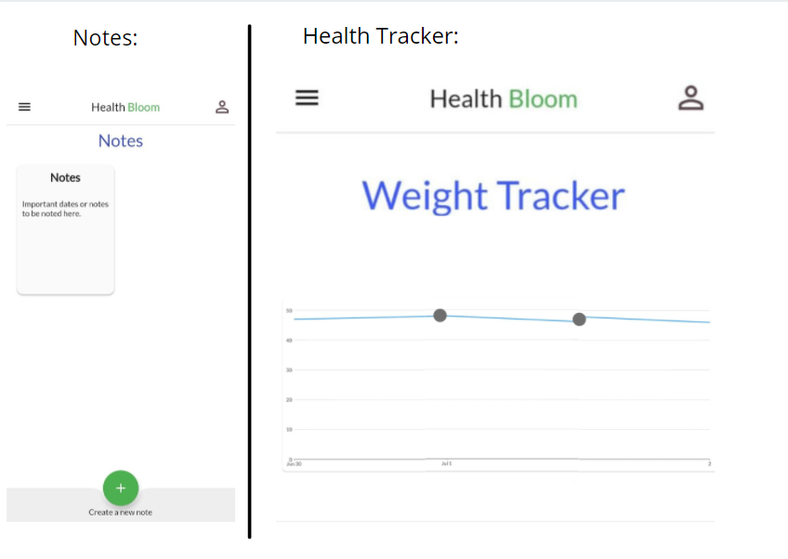
results

Slide 19
Future scope
Even though our application looks exhaustive there are still some features that could be added into the app. Like adding the near by medical pharmas or including home delivery of medicines etc. As of now including the home delivery of medicines is a sensitive issue that could lead to unforeseen problems , but the model could be implemented once the laws of e-commerce are made more clear for drug transfers.

Slide 20
conclusion
In toto ,as shown in the previous chapters ,all these features help to make user friendly UI for our Health Bloom app. So searching for nearby hospital and locating it and making a doctor appointment are more easier. And all the reminders help us not to miss any appointments or prescriptions. We sure of our app would do more service than we expect it to be with all the features embedded.

Slide 21
reference
https://www.researchgate.net/publication/335060149_Healthcare_Android_apps_a_tale_of_the_customers'_perspective
https://www.researchgate.net/publication/268224586_Mobile_Health_mHealth_Apps_for_Improved_Health_in_Medicine
https://www.jmir.org/2014/9/e210/
https://www.hindawi.com/journals/bmri/2019/7151475/
https://www.researchgate.net/publication/325791990_Application_of_Firebase_in_Android_App_Development-A_Study

Slide 22


